Slide 1

Impact of Covid-19 on Housing Prices Multnomah County, Oregon
DATA 512 A: Human Centered Data Science
Presentation by Juhi Choubey

Slide 2



Motivation #1 (Work from HOME)

Slide 3
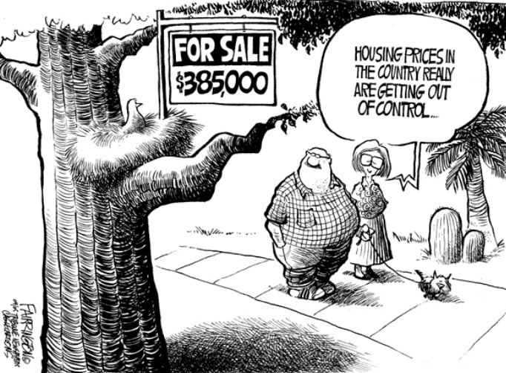
Motivation #2 (Sensitive Supply Demand)

Slide 4
Research Questions
Did #confirmed cases have a statistically significant impact on housing prices between 2020-2021?
Was there a significant difference between housing prices prior vs during pandemic?

Slide 5
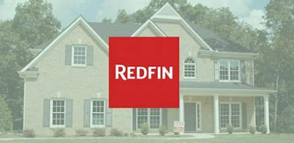


Data Sources

Slide 6
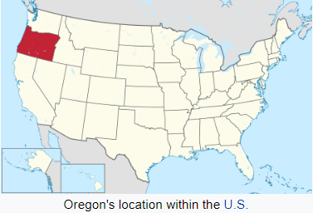

Project Scope
Multnomah County, OR
Population: 815428 (2020 census)
*Including 2019 for 1st part of the analysis

Slide 7
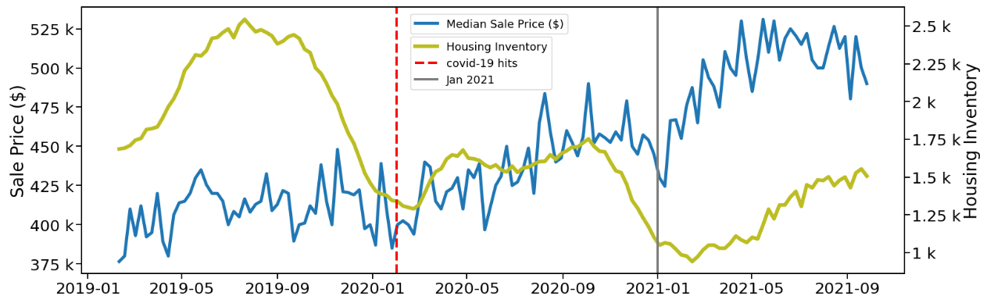
Housing Market (Pre Covid vs During Covid)

Slide 8
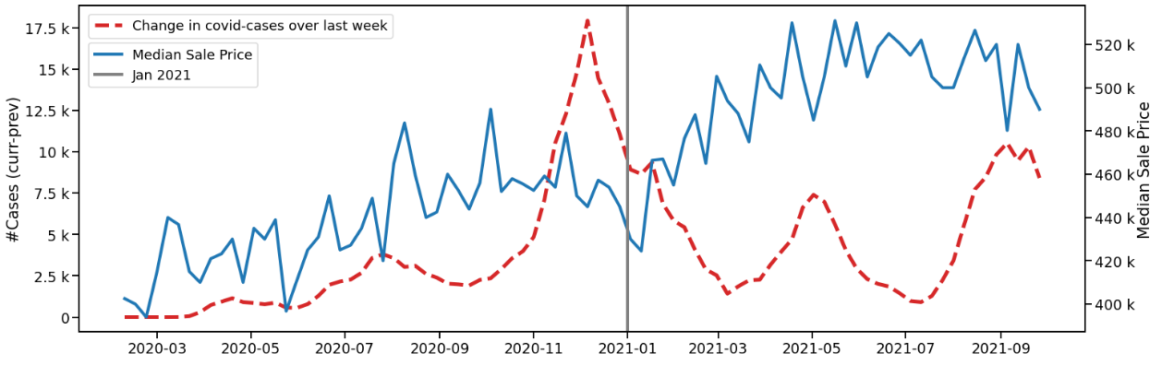
Trend of House Prices with Covid-19 cases

Slide 9
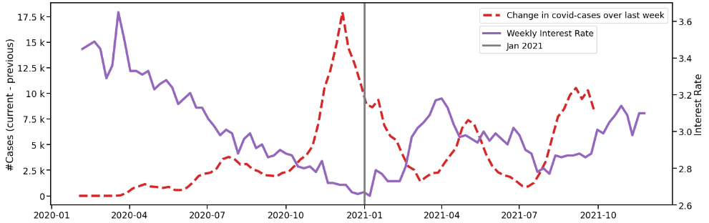
Trend of Interest Rates with Covid-19 cases

Slide 10
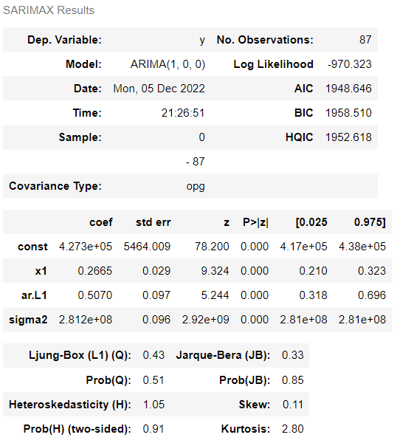


ARIMA Results (Sale Price conditioned on covid-19 cases)

Slide 11
Caveats
Socio-Political & Economic Effects
Deaths & Hospitalizations Rates
Vaccinations

Slide 12
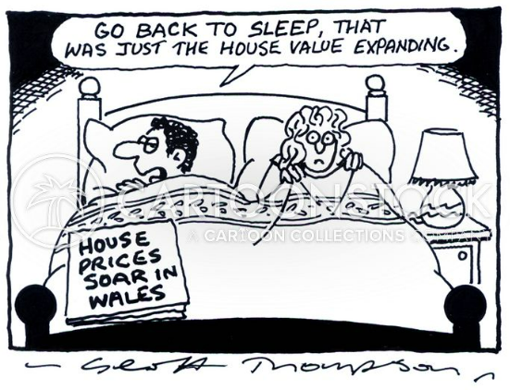


Human-Centered?

